Slide 1
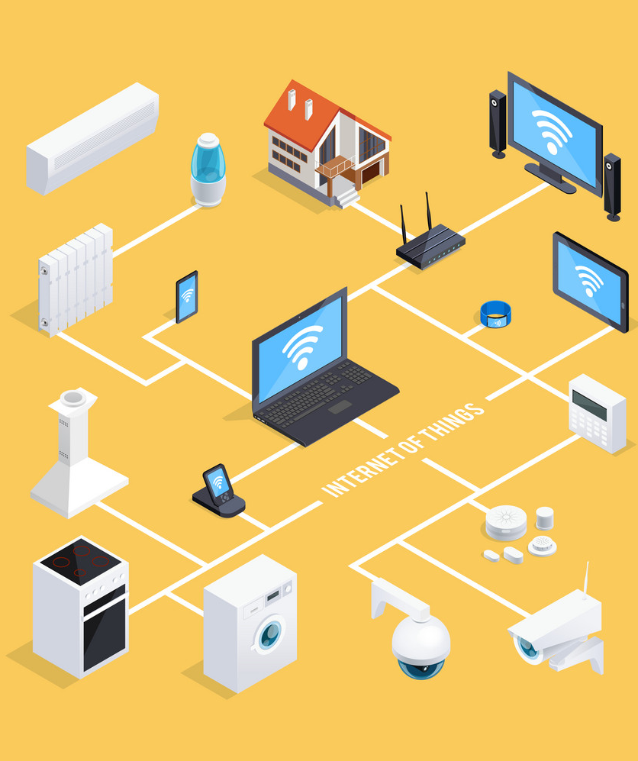
SMART HOME SYSTEM
Hammad Javaid i21-1661
Abdul Moiz i21-2687
Huzaifa Ali i21-1751
Moiz-ur-Rehman i21-2671

Slide 2
We will be introducing you to smart homes…
A brief introduction
Background
Working
Advantages & Disadvantages

Slide 3

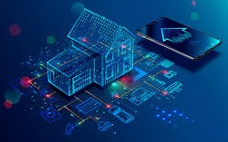
Definition - Smart Home
Smart Home technology gives you ultimate control over your home by automating the lighting system, electrical systems, audio and security systems etc.
Smart homes connect all the devices and appliances in your home so that you can communicate with each other.

Slide 4
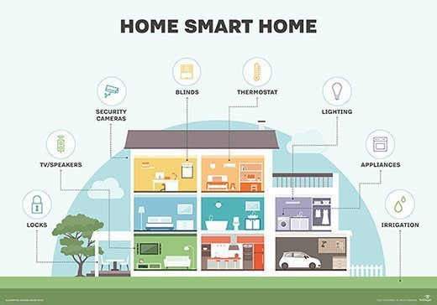
Introduction
A smart home is equipped with technology to remotely control (from within or outside the dwelling) and automate household systems.

Slide 5




Transforming a home into smart home:
3 key elements
1) An internal communication network – wired/wireless/ mixed
2) Intelligent control – gateway to system management
3) Home automation – Linking components within the house to relevant external systems.

Slide 6
Smart Home Evolution
1901 – 1920– The invention of home appliances
Mid-60s– General Electric Company-
They were one of the first pioneers to develop a series of
products made for smart homes in the mid 60’s, these
products included portable automatic dishwashers and
microwaves.
1975 – X-10 systems
This technology involved utilizing basic household wiring in
order to enable the household to become synchronised “smart”.
1984- American Association of Home Builders suggested
the term “Smart Homes.”
1991 – Gerontechnology
Research in making the lives of senior citizens easier.
1998 – Early 2000s – Smart Homes

Slide 7
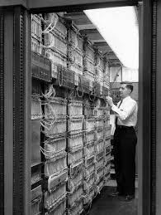
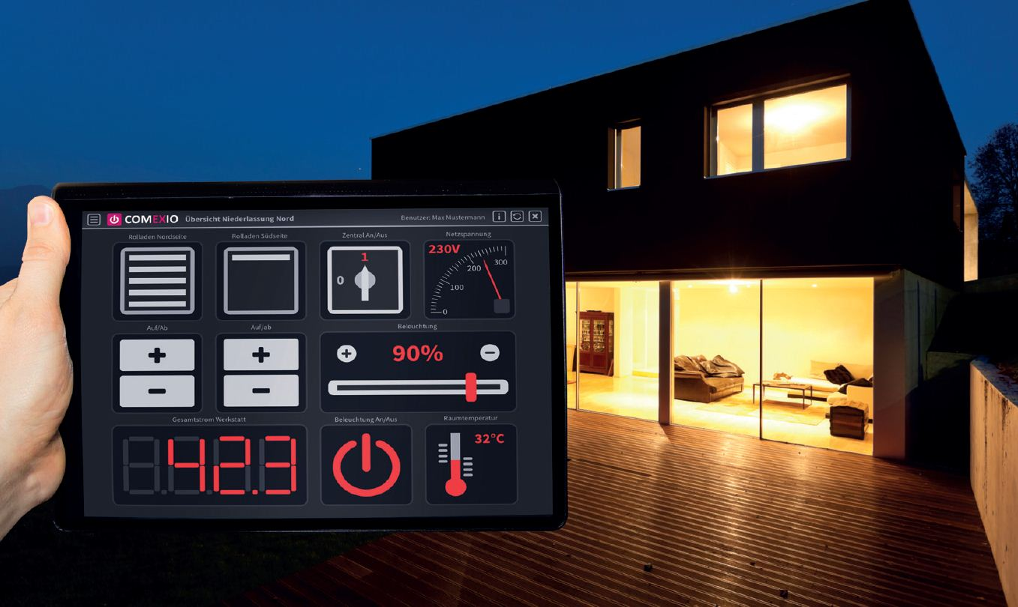
ECHO IV (1969)
SMART HOME (2018)

Slide 8






Smart Home objectives:
Maximum inhabitant productivity
Minimize operating costs
Enhance sustainability
Energy conservation
Improve quality of living
Security and Privacy

Slide 9






Major Service Ares
Major Service Areas
Environmental
Security
Entertainment
Domestic Appliances
Information and communication
Health
Energy Management
Water leaks
Alarms
Person recognition
Motion detectors.
Windows and door control
surveillance
Audio
Visual
Multimedia
Theatre
Mirror tv
Maintenance alerts
Cooking
Cleaning
Watch/feed pets
Phone
Caller IDS’
Internet
intercoms
Assistance for elderly & disabled.
Emergency assistance systems

Slide 10
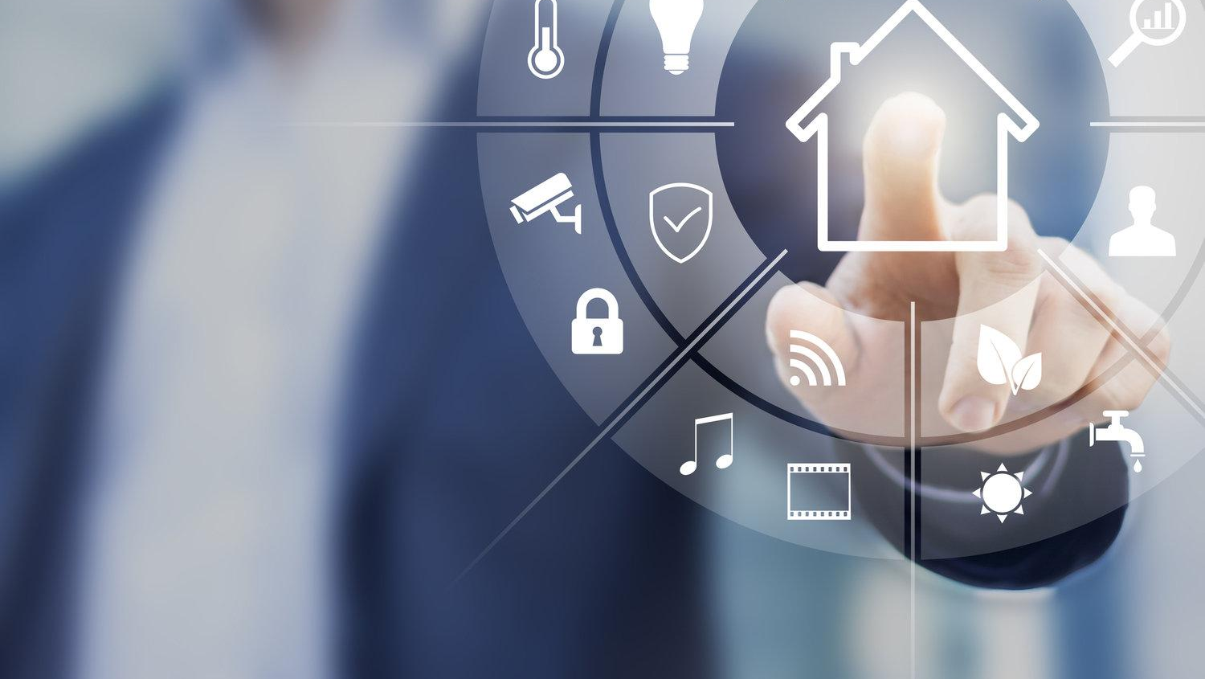
How Do Smart Homes Work?
The system is programmed along the guidelines of AI.
Information stored using Deep Learning and Machine Learning algorithms.
New information is learned by the AI, to predict and make decisions.
One whole system

Slide 11
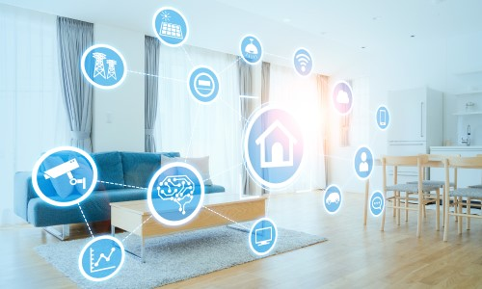
The system uses the following
to understand and store information:
Gestures
Voice recognition, facial and movement recognition
Sensors
Patterns/Daily routine
Activities

Slide 12
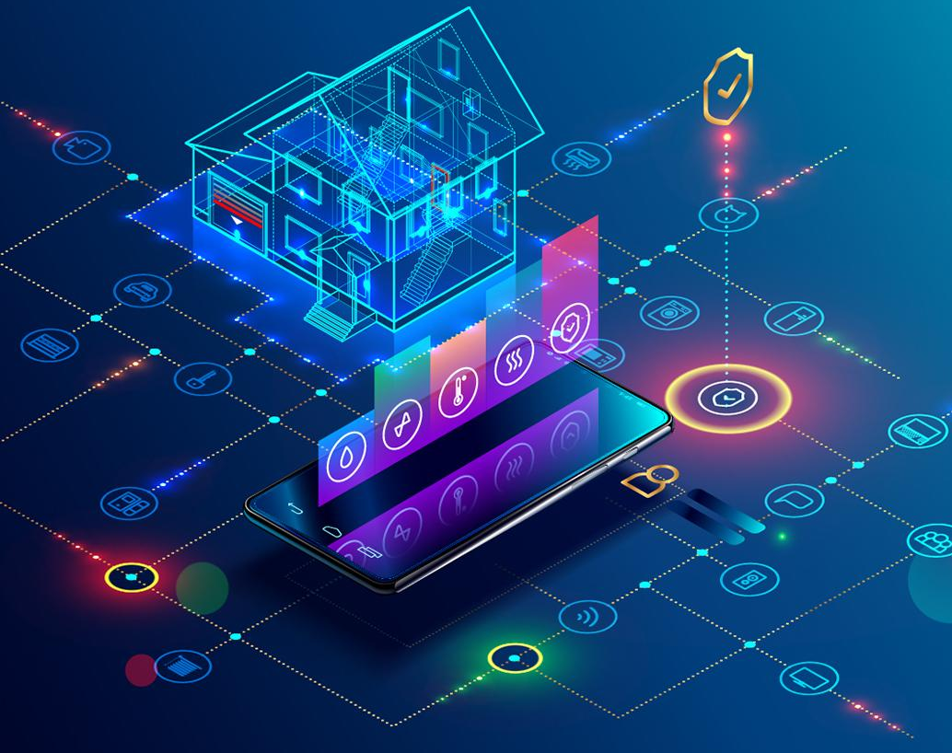
Features Of A Smart Home
Security system – smart locks, cameras, gate control
Doors
Blinds
Lighting
Thermostat
Water supply + irrigation
Smoke detectors
Entertainment system
Kitchen appliances
Smoke detection

Slide 13
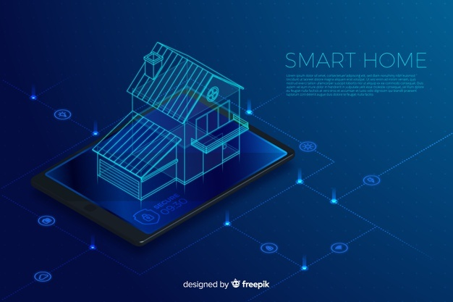


Slide 14



ADVANTAGES AND DISADVANTAGES
C

Slide 15
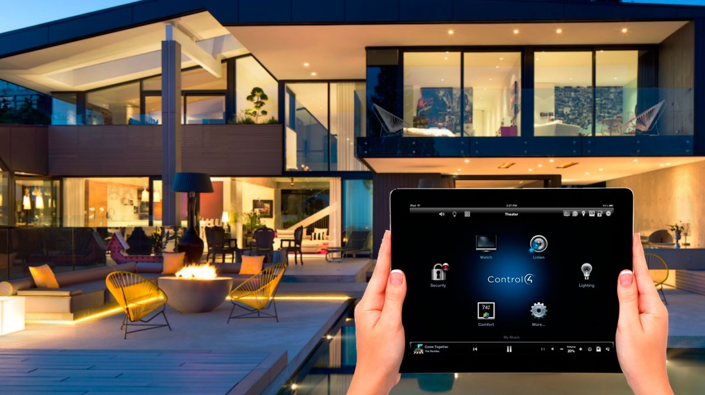
Advantages
Convenience.
Increased home security through automated locks.
Programmed temperature and lighting control is both convenient and saves electricity and bills.
Most smart home devices can be remotely controlled meaning you have access to your home even when you are away.
Finally, Smart home systems are super classy.

Slide 16

Disadvantages
Equipment and installation costs are quite high.
Any damage to interconnections can disrupt the system.
Privacy issues if home surveillance footage gets into the wrong hands.
It will take time for people to get used to it. Some people believe that it will make their life too complicated.
Risk of getting hacked – costs of firewall, vpn, proxy, etc.

Slide 17
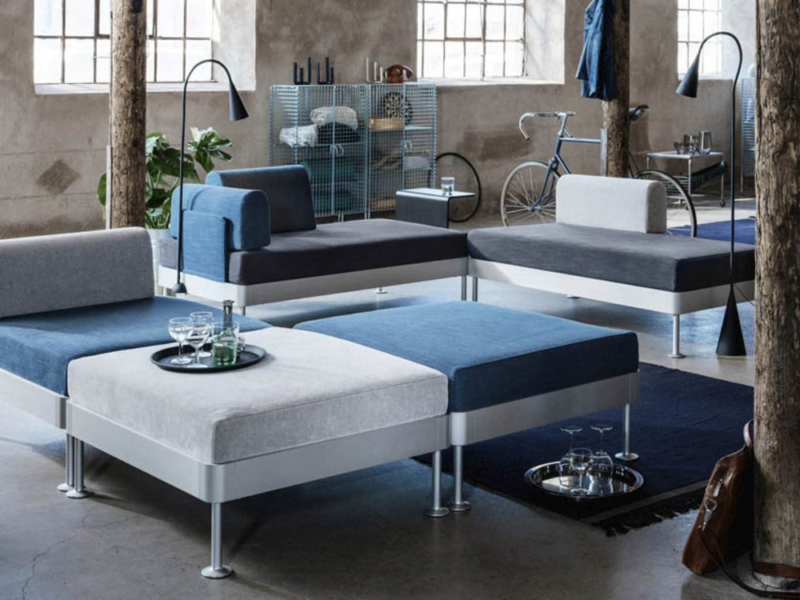
Future of smart homes…
Features that are anticipated in future smart homes are:
Refrigerators taking notes and placing order when containers reach a certain level
Same can be done by ‘smart garbage cans’, when they are thrown out.
Digital cutting boards
AI placing human sounding phone calls
Analyst estimate global smart home market could be worth $107 by 2023.

Slide 18

ANY QUESTIONS?
C
Thank you!

